Slide 1
Have a Question?
sli.do
#fund-python
<number>
Notes:
<number>
© SoftUni – https://softuni.org. Copyrighted document. Unauthorized copy or reproduction is not permitted.

Slide 2












SoftUni Diamond Partners

Slide 3


Educational Partners
<number>

Slide 4

Course Objectives

Slide 5
Python Fundamentals Objectives
Working with linear data structures
Lists
Defining functions and simple classes
Working with objects
Processing and manipulating strings
<number>

Slide 6
Practical Programming Exam
Mid Exam – 4 hours
3 practical problems
Conditional Statements and Loops
Linear Data Structures – Lists
Final Exam – 4 hours
3 practical problems
Dictionaries
Strings and Text Processing
<number>

Slide 7
Theoretical Exam
You will have 30 minutes once you enter
Multiple-choice with 1 correct answer
Test will be in English
Automated quiz system
Available online on the day of the practical exam
You can submit your answers just one time
<number>

Slide 8

The Team

Slide 9
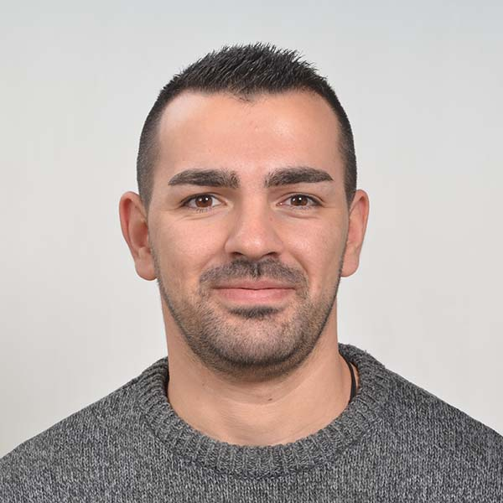
Mario Zahariev
Top student at SoftUni
Master of Cyber Security
3+ years of experience on Python
Interested in JavaScript, Artificial Intelligence and Go
Involved in researches related to artificial intelligence and
<number>
Notes:
<number>
© SoftUni – https://softuni.org. Copyrighted document. Unauthorized copy or reproduction is not permitted.

Slide 10
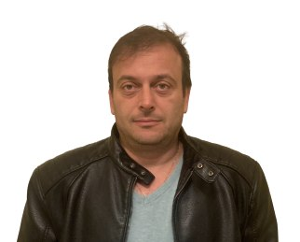
Ivan Shopov
DevOps & Software Developer at IBM
Top Student at SoftUni
Technical Trainer at SoftUni
<number>

Slide 11

Course Organization

Slide 12
Python Fundamentals Module
16-May-2022
26-Jun-2022
07-Aug-2022
11-Aug-2022
15-Aug-2022
Python Fundamentals
12 weeks * 3 times / week
12 credits
Start: 16-May-2022
Mid Exam: 26-Jun-2022
Final Exam: 07-Aug-2022
Theoretical Exam: 07-Aug-2022
Re-Take Exams
Mid Exam Retake: 11-Aug-2022
Final Exam Retake: 15-Aug-2022
Theoretical Exam: 15-Aug-2022
<number>

Slide 13
Course Scoring
Practice grade:
Theory grade:
SoftUni Certificate: 5.00 from Practice
CPE Certificate: 3.00 average from Practice +
Practical Mid Exam
Practical Final Exam
Homework
40 %
60 %
+5 %
Theoretical Exam
100 %
<number>
<number>
Notes:
<number>
© SoftUni – https://softuni.org. Copyrighted document. Unauthorized copy or reproduction is not permitted.

Slide 14

Homework Assignments & Exercises
Your homework is mainly work in class
Lesson days → slides + live demos + exercises
Exercise days → only exercises
How to submit your homework?
Submitted in the judge system
Do your homework when it's due
Assignments pile up quickly
<number>

Slide 15



Course, Forum and FB Group
Official web site:
Official discussion forum:
Official Facebook group:
Python Community Facebook group:
https://softuni.bg/trainings/3733/programming-fundamentals-with-python-may-2022
https://softuni.bg/forum/categories/784/python-fundamentals
https://www.facebook.com/groups/ProgrammingFundamentalswithPythonMay2022
https://www.facebook.com/groups/SoftUniPythonCommunity
<number>
Notes:
<number>
© SoftUni – https://softuni.org. Copyrighted document. Unauthorized copy or reproduction is not permitted.

Slide 16

License
This course (slides, examples, demos, exercises, homework, documents, videos and other assets) is copyrighted content
Unauthorized copy, reproduction or use is illegal
© SoftUni – https://softuni.org
© Software University – https://softuni.bg
<number>
Notes:
<number>
© SoftUni – https://softuni.org. Copyrighted document. Unauthorized copy or reproduction is not permitted.

